Slide 1
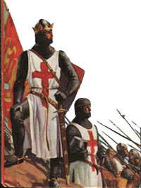
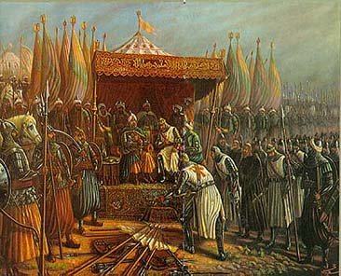
The Crusades

Slide 2
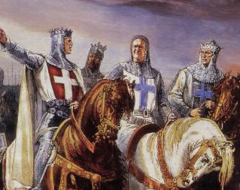
Background
During the Age of Faith in the European Middle Ages
Byzantine emperor asks for help from Christian Western Europe against threatening Muslim Turks

Slide 3
Background
“Come then, with all your people and give battle with all your strength, so that all this treasure shall not fall into the hands of the Turks…Therefore act while there is still time lest the kingdom of the Christians shall vanish from your sight and, what is more important, the Holy Sepulchre [the tomb where Jesus was buried] shall vanish. And in your coming you will find your reward in heaven, and if you do not come, God will condemn you.”
– Byzantine Emperor Alexius Comnenus

Slide 4
Background
Popes begin to call for Crusades – holy wars - to gain control of the Holy Land (Jerusalem)
Crusaders are promised a place in heaven if they died on a Crusade
Over 300 years several Crusades are launched; all become weaker & soldiers get greedy

Slide 5
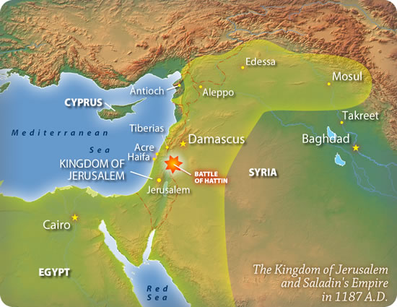
Motives …Why Go?
Pope wants to reclaim Jerusalem & re-unite Christianity
Kings use the Crusades as an excuse to send away unruly knights

Slide 6
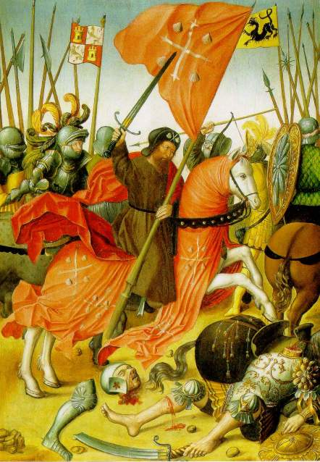
Motives …Why Go?
Younger sons join Crusades in hopes of earning land or winning glory through fighting
Merchants join the Crusades to gain wealth through trade
Pope promises Crusaders who die a place in heaven

Slide 7
Motives
“Let the Holy Sepulchre [the tomb where Jesus was buried] of our Lord and Saviour, which is possessed by the unclean nations, especially arouse you…This royal city [Jerusalem], situated at the center of the earth, is now held captive by the enemies of Christ and is subjected, by those who do not know God, to the worship of the heathen. Accordingly, undertake this journey eagerly for the remission of your sins, with the assurance of the reward of imperishable glory in the kingdom of heaven.
– Pope Urban II, 1095

Slide 8
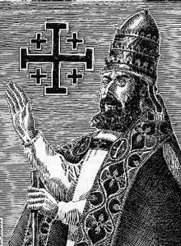
The First Crusade
“God wills it!”
Pope Urban II launches the First Crusade to recover Jerusalem from Muslim rule (1095)

Slide 9
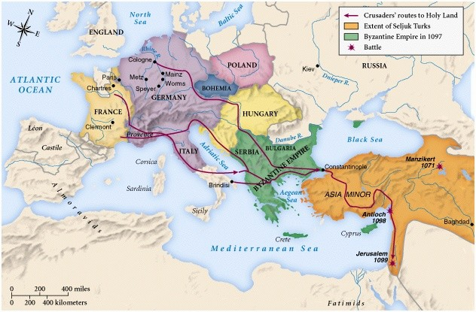
The First Crusade
Armies from Western Europe pass through Constantinople

Slide 10
The First Crusade
Crusader armies captured Jerusalem in 1099 and massacred Muslim & Jewish residents

Slide 11
The First Crusade
“It was impossible to look upon the vast numbers of the slain without horror; everywhere lay fragments of human bodies, and the very ground was covered with the blood of the slain. It was not alone the spectacle of headless bodies and mutilated limbs strewn in all directions that roused horror in all who looked upon them. Still more dreadful was it to gaze upon the victors themselves, dripping with blood from head to foot, an ominous sight which brought terror to all who met them.”
– William of Tyre, Christian Bishop on eyewitness accounts

Slide 12
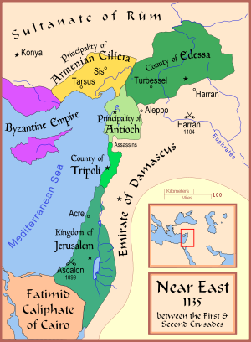
The First Crusade
4 ‘Crusader states’ are created from captured land
(Edessa, Antioch, Jerusalem & Tripoli)

Slide 13
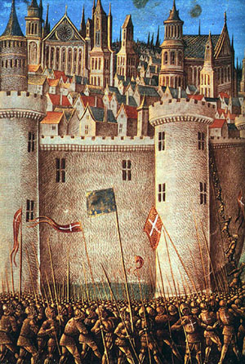
The Second Crusade
Launched after Muslims gain control of a ‘Crusader State’ in 1144
Christian armies fail to defeat the Muslims
Saladin leads the Seljuk Turks; conquers Jerusalem in 1187

Slide 14
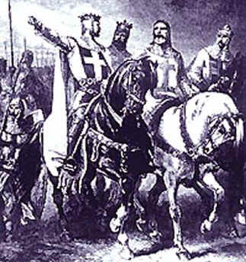
The Third Crusade
“Crusade of Kings”
3 powerful rulers:
Richard the Lionhearted (England)
Philip II (France)
Frederick I (Germany)
Phillip & Richard argue; Richard drops out and takes army home
Frederick I drowns during the journey; his army disbands

Slide 15
The Third Crusade
Richard I makes peace with Saladin in 1192
Agreement between Saladin & King Richard gives Jerusalem to Muslims, but allows Western pilgrims access to Christian holy places
TRUCE!

Slide 16
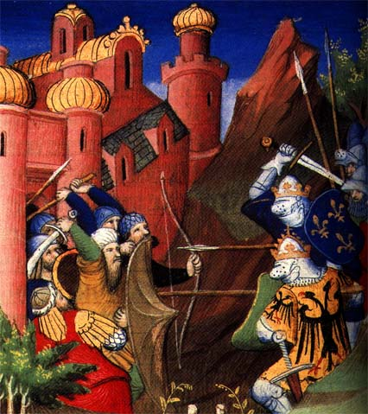
Later Crusades
Other popes call for later crusades, but each one is weaker than the last
By the 13th century, the Western powers pose little problem for the Turks

Slide 17
Later Crusades
The Crusades weaken Constantinople & the power of the Byzantine Empire
During the 4th Crusade, Christians destroy Constantinople
2 other Crusades strike Egypt but fail to weaken the Muslims

Slide 18
Effects of Crusades
Crusades demonstrate the power of the Church
Merchants expand trade, bringing goods to Europe from Asia

Slide 19
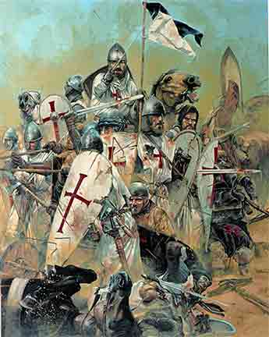
Effects of Crusades
Failure of later Crusades weakens pope & nobles, strengthens the power of kings
Create a lasting bitterness between Christians & Muslims

