Slide 1
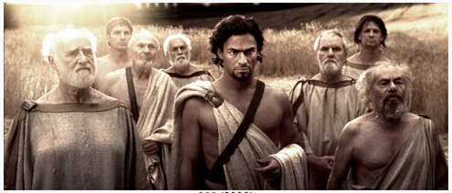
The Greek City-States
Ch. 4 (pp. 116 - 129)
Key Concept 2.1 The Development and Codification of Religious and Cultural Traditions
Key Concept 2.2 The Development of States and Empires
Essential Question: What were the distinctive beliefs, philosophies, and arts of Greek civilization?

Slide 2
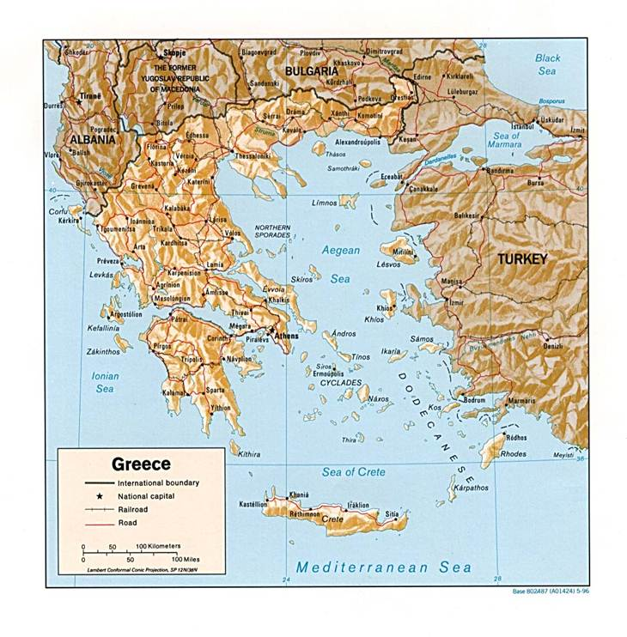
The Rise of the Greeks
Greek civilization arose in the lands around the Aegean Sea
Land around the Aegean was difficult to navigate
Sea travel become preferred method of commerce

Slide 3
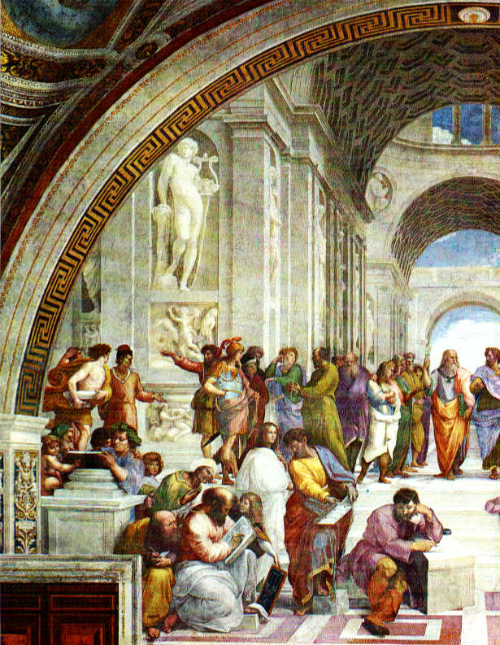
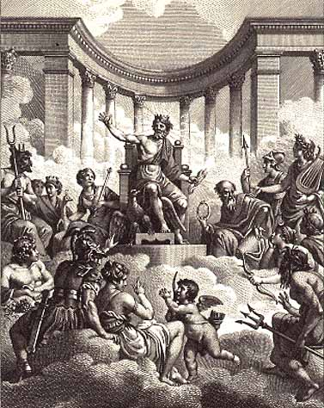
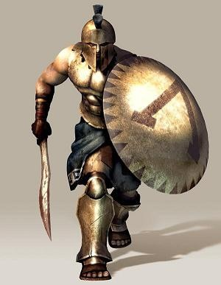
The Emergence of the Polis
Due to geographical isolation city-states (polis) developed in Greece, as opposed to a single centralized empire
Often shared many similarities
Ex. Basic religious tenets
Ex. Patriarchal social structures
Could also differ in terms of cultural, political, economic traits
Ex. Athens vs. Sparta

Slide 4
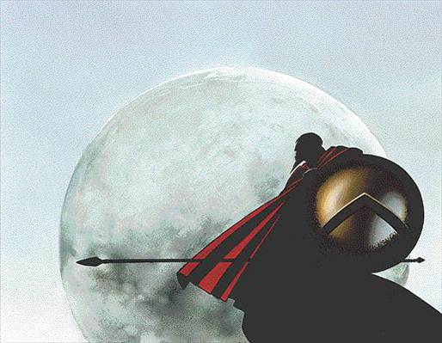
The Persian Wars
Greek city-states often warred with one another, but unified in the 400s B.C.E. when they were attacked by the Persians
The Persian Wars
Greeks under the leadership of Athens defeated the Persians

Slide 5
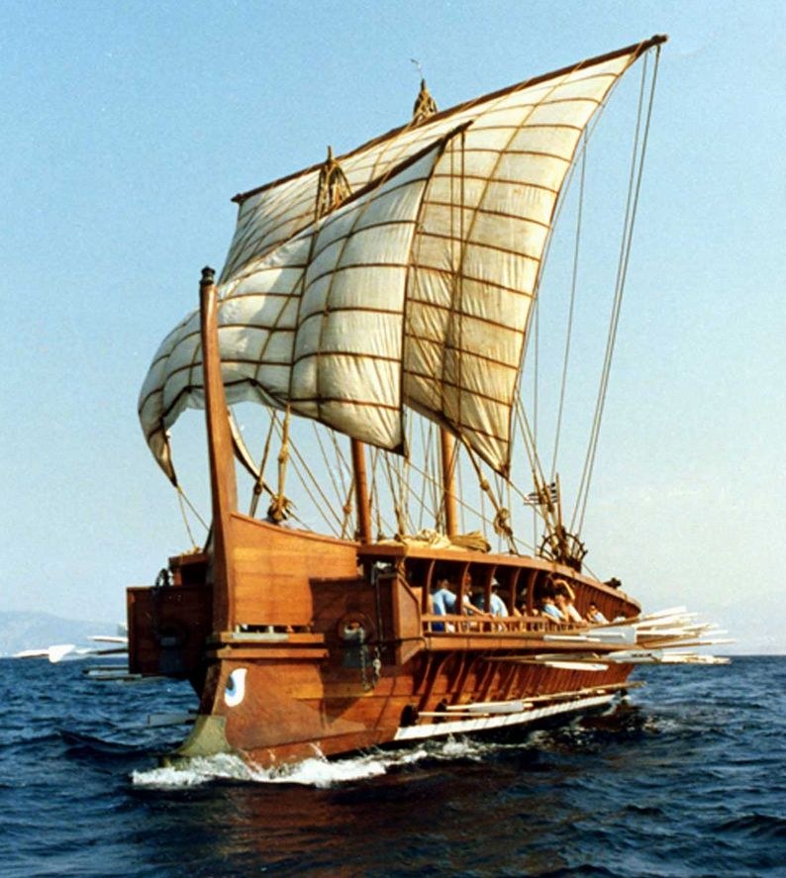
The Athenian Empire
As a result of the Athenians success, Athens, in essence, became the center of the Greek Empire
Athens projected military power of its weaker neighbors
The Hellenic League (req. tribute payments)
Experienced a golden age of culture & commerce

Slide 6
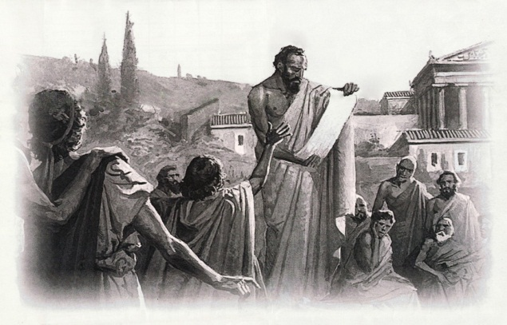
The Golden Age of Athens
Legal systems (law codes) & bureaucracies were created to control subjects
Ex. Athenian democracy

Slide 7
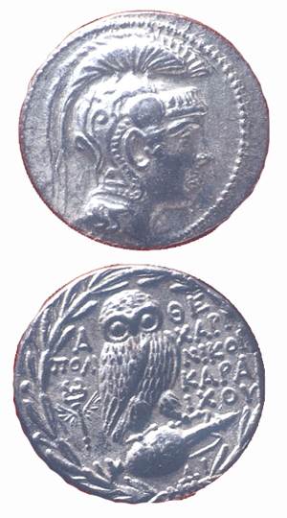
The Golden Age of Athens
Trade was promoted and currency was issued
Patriarchal social structures included classes such as slaves, artisans, merchants, elites, etc.

Slide 8
The Golden Age of Athens
Forms of artistic expression were developed that later influenced neighboring regions in later time periods
Ex. Greek plays

Slide 9
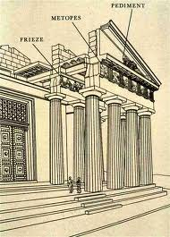
The Golden Age of Athens
Distinctive architectural styles were developed
Marble or limestone
Decorated frieze
Columns supported by base

Slide 12
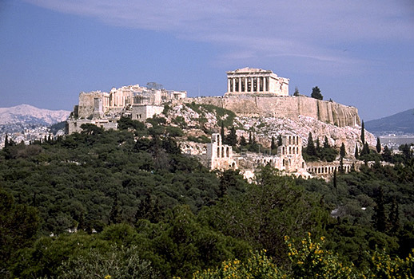
The Golden Age of Athens
The city of Athens itself served as:
Center for trade
A place for religious ceremonies
Hub of political administration

Slide 13
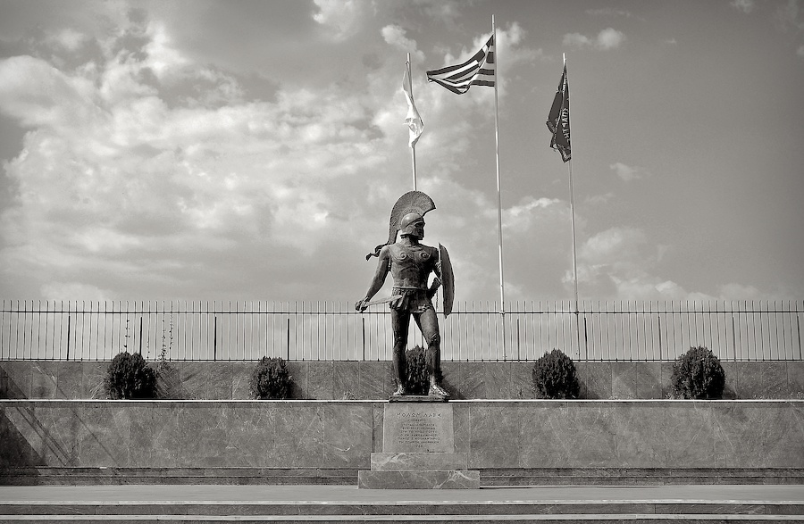
The Fall of the Greeks
Athens fell in 404 B.C.E. to the Spartans as a result of the inequality of imperial rule
Peloponnesian Wars
By 387 B.C.E., the Greeks were exhausted from civil war and were unable to prevent the Persians from reconquering most of Greece

