Slide 1
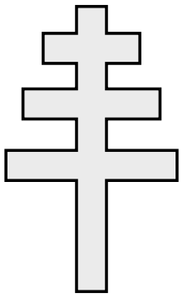
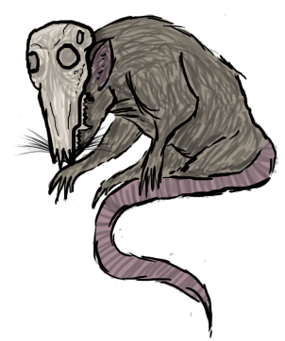
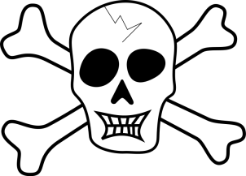
The Decline of Feudalism: The Disasters of the Late Middle Ages
The Church Scandal (The Schism)
The Hundred Years War
The Black Death:
Following a conflict between the French king & the Pope, a French archbishop was chosen to be Pope
Pope Clement V moved the papacy to Avignon, France where it remained for over 70 years
In 1377 TWO popes were elected - one French and one Italian
Neither would resign
Lasted until 1417 when a church council finally decided on one pope
Dispute between English and French over the French throne
English advantage: Long Bow
Joan of Arc – French peasant who had visions/heard voices to drive English from France
France wins, French king Charles VII was crowned
Joan of Arc captured & English turned her over to church – burned at the stake as a heretic
Plague that wiped out 1/3 to 1/2 of the population of Europe
The plague was initially spread by fleas on black rats that came to Italy on trade ships (not known until 20th century)
People thought it was punishment for sins
Population declined
Less trade
Serfs left manors
Challenges to the
STATUS QUO
Overall, the 3 disasters of the 14th century caused people to question traditions
Effects of The Schism:
Effects of the Hundred Years War:
Effects of the Black Death:
People felt that many of the clergy were more concerned with wealth and power than anything
Nationalism!
King recognized as more powerful than feudal lord or church
Serfdom ended because labor was in such demand after the plague; People lost faith

