Slide 1
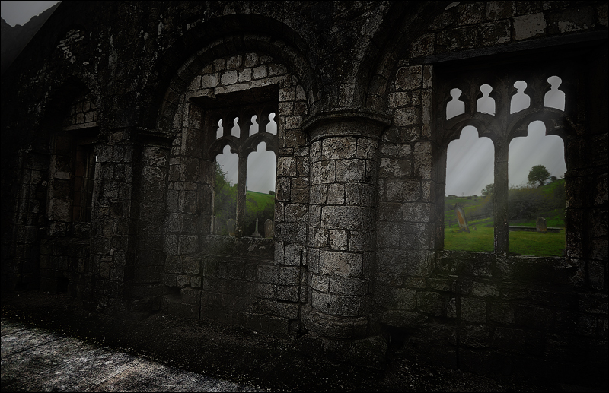
The Power of the Medieval Church

Slide 2
The Role of Religion & Organization

Slide 3
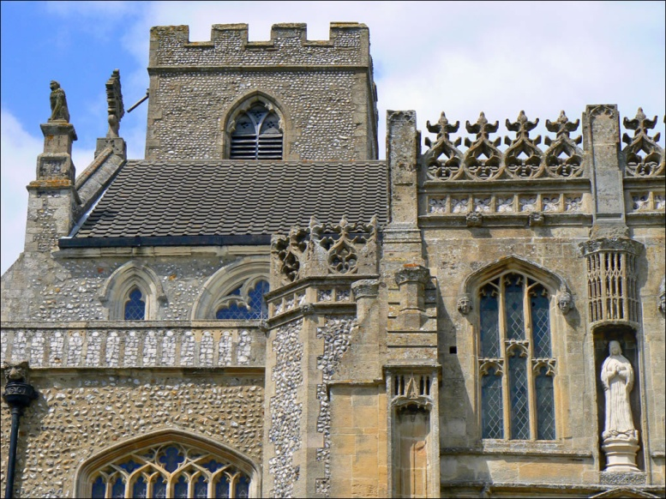
Role of Religion
During the Middle Ages the Catholic Church was the most powerful institution in Western Europe
The Church was the center of most peoples’ lives

Slide 4
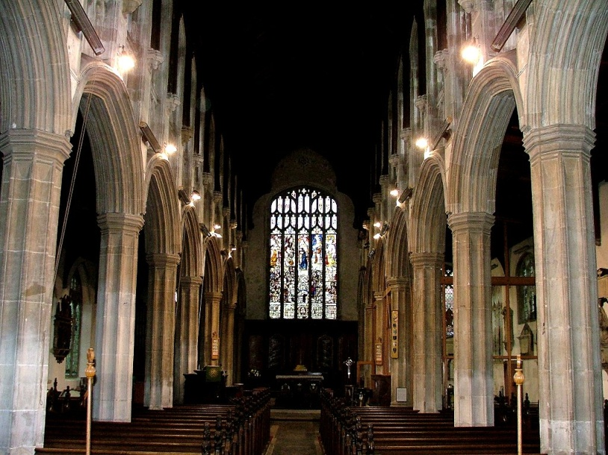
Role of Religion
The Church taught that:
All people were dependent & reliant on God’s grace
To receive grace one must take part in the sacraments (church rituals); without God’s grace/sacraments, can’t go to heaven!

Slide 5
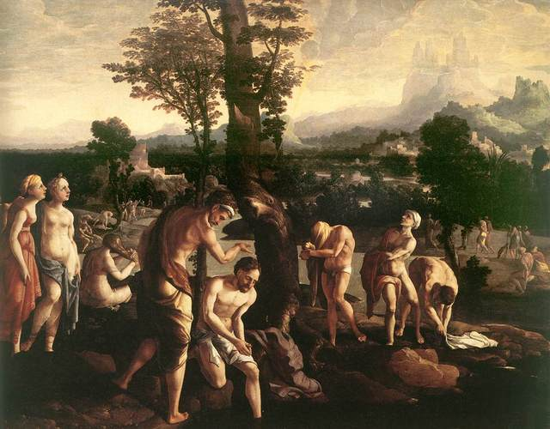
Role of Religion
7 Sacraments:
Baptism, Penance, Eucharist, Confirmation, Holy Orders, Matrimony & Anointing of the Sick

Slide 6
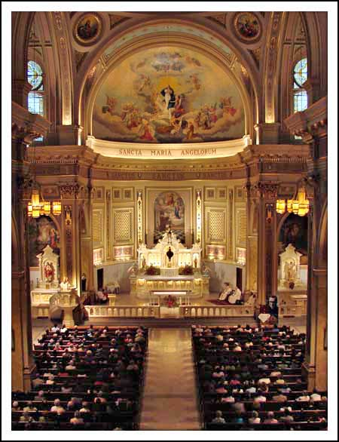
The Power of Mass
Mass = name for Church services
Mass conducted in Latin
Most peasants did not understand it
Gave priests lots of power over people – Why?

Slide 7
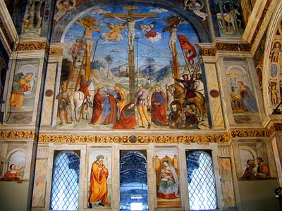
The Power of Mass
Peasants got their religious knowledge from statues, paintings, stained glass windows, etc…

Slide 8
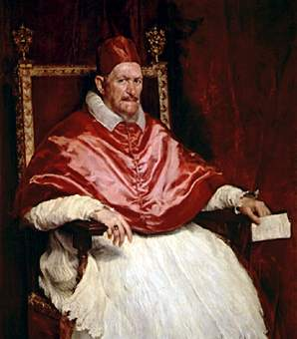
Church Organization
Church Hierarchy:
Pope
Archbishop
Bishop
Priest

Slide 9
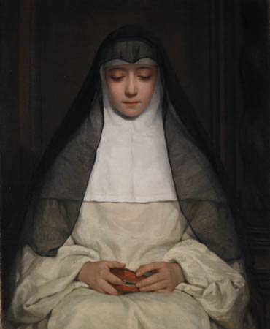
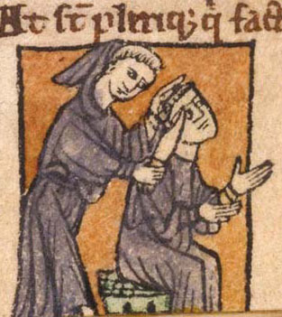
Church Organization
Clergy: religious officials
Includes Churchy hierarchy + monks/nuns who lived apart from society

Slide 10
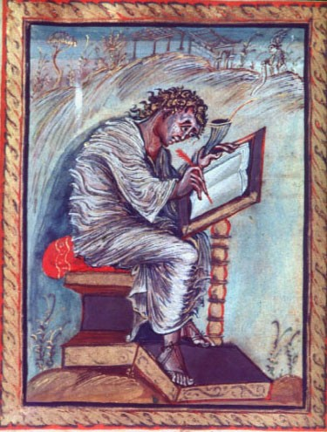
Monastic Life
Men (monks) → lived in monastery
Women (nuns) → lived in convent
Notes:
Dress simply, aid the community, live in silence…

Slide 11
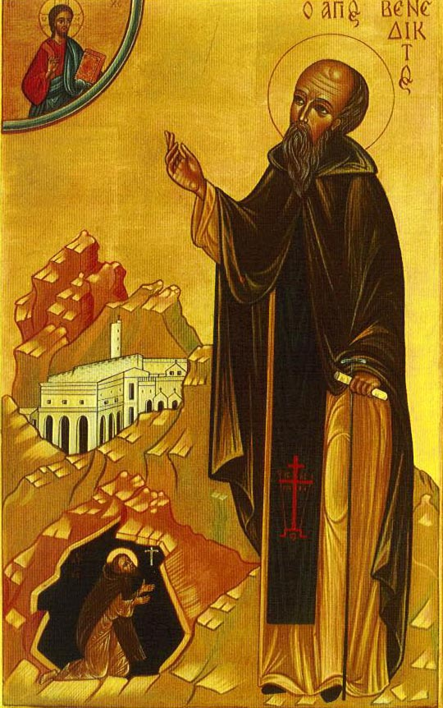
Monastic Life
Both…
Dress simply
Aid the community (schools & hospitals)
Live separate from the rest of the world
Preserve ancient religious works & ancient writings; copy books by hand
Notes:
Dress simply, aid the community, live in silence…
Provided:
Aid for the sick
Schools for the children
Food for the needy
Guest houses for weary travelers

Slide 12
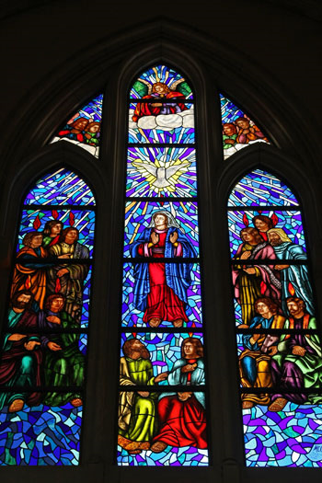
Monastic Life
The Power of the Medieval Church
Both…
Dress simply
Aid the community (schools & hospitals)
Live separate from the rest of the world
Preserve ancient religious works & ancient writings; copy books by hand
Notes:
Dress simply, aid the community, live in silence…
Provided:
Aid for the sick
Schools for the children
Food for the needy
Guest houses for weary travelers

Slide 13
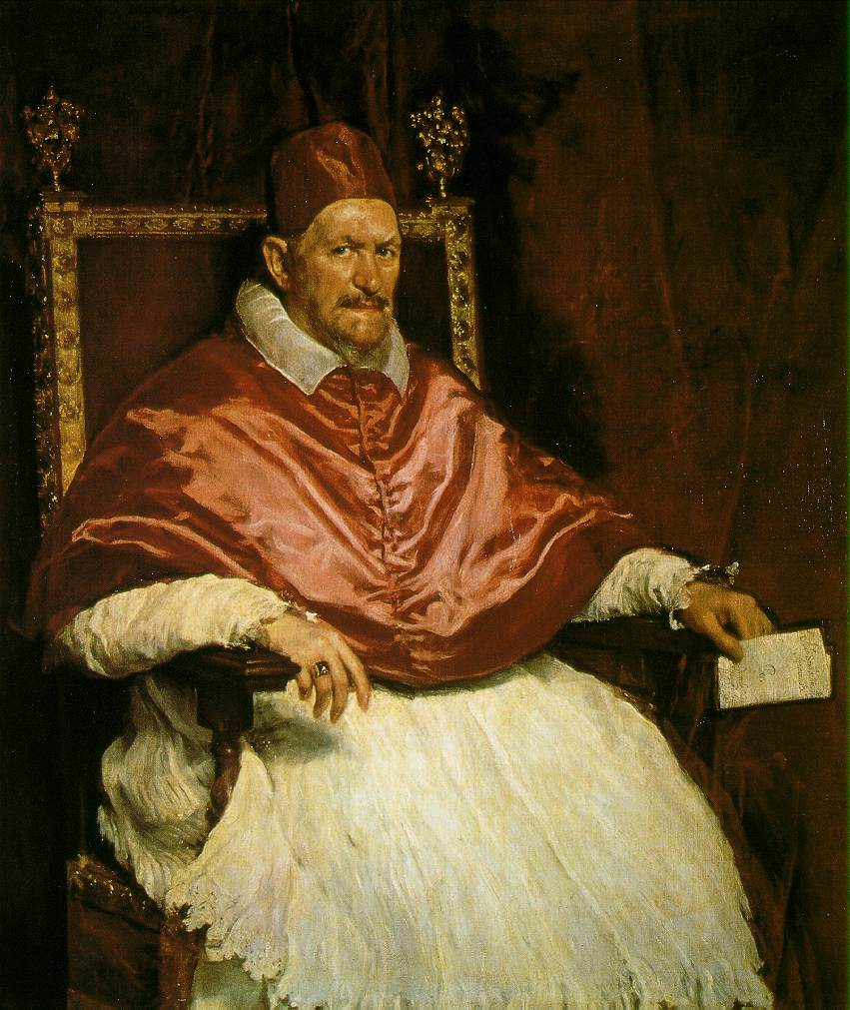
Power of the Church
The Medieval Catholic Church was a powerful political force
Helped to govern Western Europe during this time period
Canon Law = Church law

Slide 14
Power of the Church
Disobedience to the Church could lead to
Excommunication – banishment from Church (can’t receive the sacraments, therefore can’t go to heaven!)
Interdict: King’s land (& all the people in it) would be banned from receiving the sacraments

Slide 15
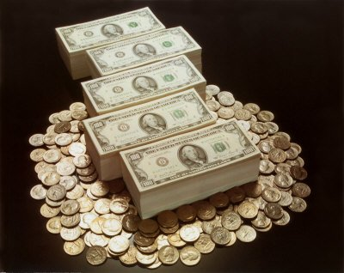
Power of the Church
Church became very wealthy from donations of land & money
Donated by nobles who wanted to ensure their salvation
As a result, nobles began to dominate & control the Church

Slide 16
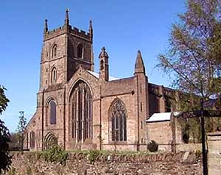
Church Reform
During this time monasteries tried to free the Church from the influence of the nobility

Slide 17
Church Reform
1059: Pope would no longer be chosen by political leaders
Pope would now be chosen by religious figures only (cardinals)

Slide 18
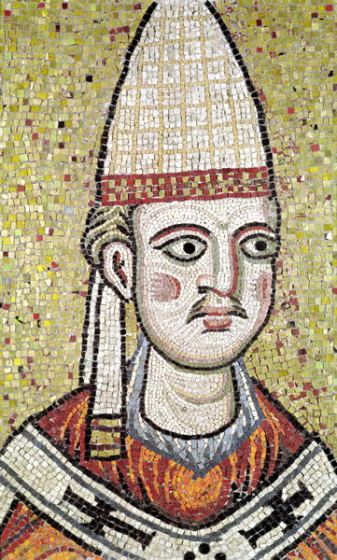
Heresy
The Church was very powerful & had courts where it tried people for crimes against the Church

Slide 19
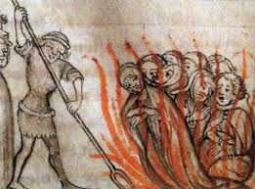
Heresy
HERESY: denial of Church teachings; one of the biggest crimes
HERETICS: (people who committed heresy) were excommunicated
Heresy considered as bad as treason

Slide 20
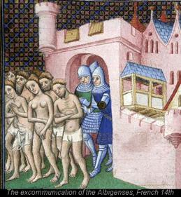
The Inquisition
A court set up to prosecute heretics in an attempt to outlaw heresy

Slide 21
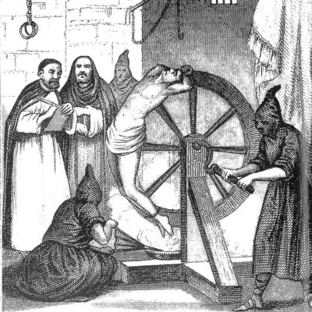
The Inquisition
People could be accused of heresy by their enemies; then they would be investigated by the Church
Often, heretics were tortured so they would confess

Slide 22
The Jewish Community
As the Catholic Church grew more powerful, Jews were blamed for ALL misfortunes
As a result, many were attacked & killed

Slide 23
The Jewish Community
ANTI-SEMITISM:
The hatred of Jews
Main source of anti-Semitism came from flawed interpretations of Christian doctrine

