Slide 1
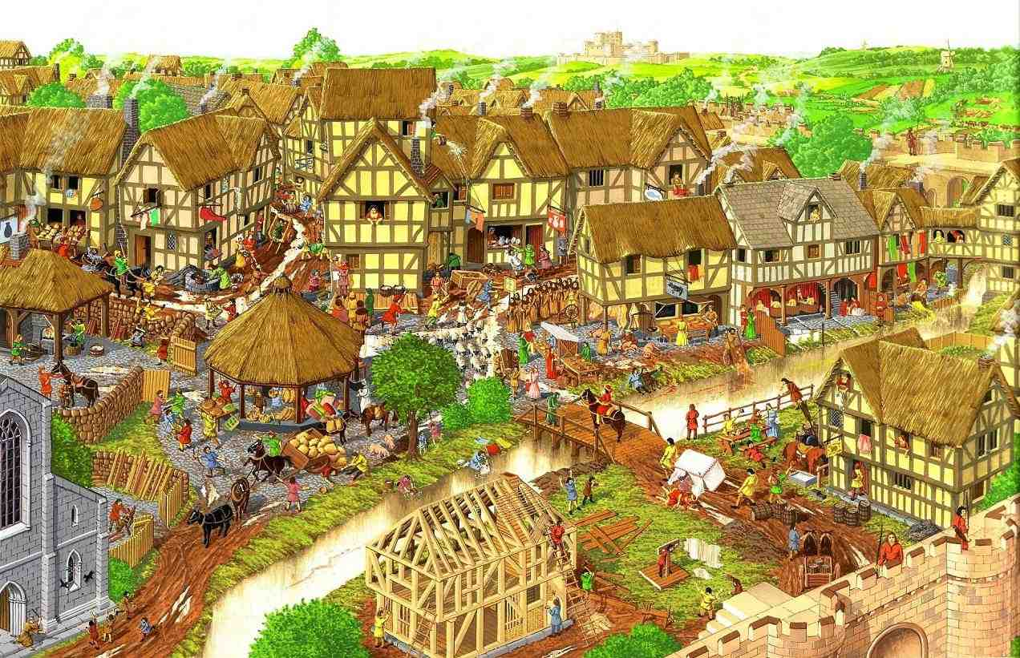
High Middle Ages:
Changes in Medieval Society:
The Rise of Commerce, Cities & Culture

Slide 2
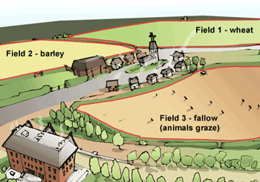
Changes in Agriculture
Horses used to plow fields; faster; increases food production & supply
The three-field system:
Plant & sow 2 fields each year, let 1 field “rest”
Increases food production, which in turn increases the population

Slide 3
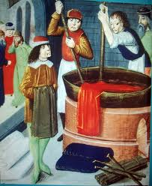
Development of Guilds
Guilds: organization of people with the same occupation
Include skilled artisans
Set standards for quality, wages, prices, working conditions
Provide security for members
Supervise training for new members
Their wealth influences government & economy

Slide 4
Development of Guilds
Rules of a British Merchant Guild:
No one in the city shall buy anything to sell again in the same city unless he is a member of the guild
If anyone does so and is convicted, the goods he bought must be turned over to the king
If any guildsman falls into poverty and is not able to work, he shall receive aid from the guild
No guild member ought to become a business partner with anyone who does not belong to the guild
When a guildsman dies, all those who belong to the guild shall attend the service, and guildsmen shall carry the body to place of burial

Slide 5
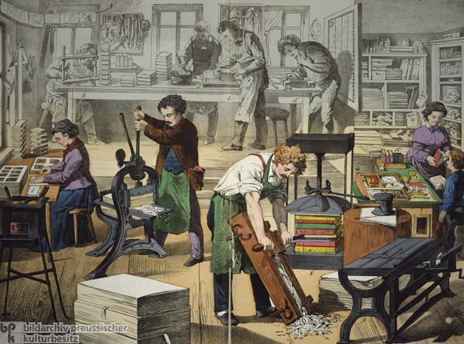

Slide 6
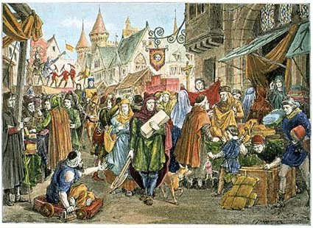
Commercial Revolution
Commercial Revolution: changes in business & trade
Merchants develop credit to avoid carrying large sums of money around
Merchants take out loans to purchase goods

Slide 7
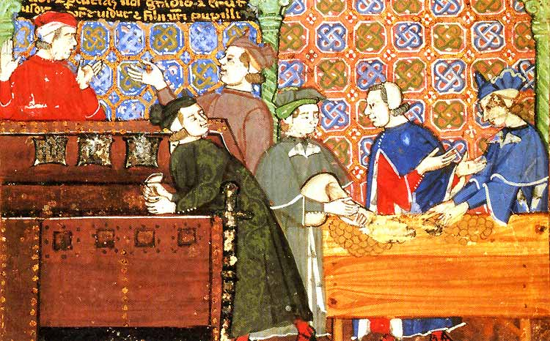
Commercial Revolution
Development of banking
Economic changes lead to the growth of cities and jobs

Slide 8
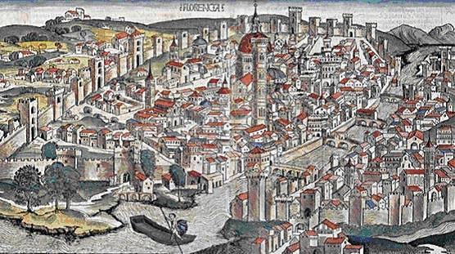
Growth of Cities/Towns
Between 1000 – 1150, Europe’s population rises to 40 million
Why?
Serfs leaving the manor for opportunities
The revival of trade
Strong monarchies to protect

Slide 9
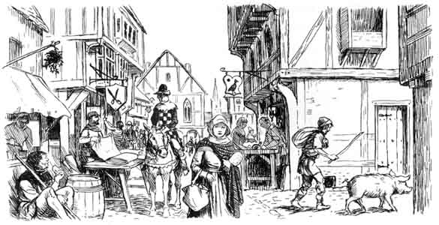
Growth of Cities/Towns
Towns are uncomfortable: crowded, dirty, fire hazards

Slide 10
Revival of Culture
Revival of trade spawns revival of culture and learning
Universities began as “learning guilds”: An association of people organized for the purpose of teaching & learning
Subjects included law, theology, & medicine

Slide 11
Revival of Culture
Vernacular: the language of everyday speech
Instead of using Latin, people began to speak the language that had developed in their own country
Gave each kingdom a separate identity
Made literature accessible to more people

Slide 12
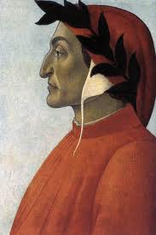
Vernacular Writers
Dante Alighieri (13th cent)
Divine Comedy: describes an imaginary journey from hell to heaven

Slide 13
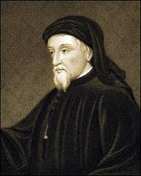
Vernacular Writers
Geoffrey Chaucer (14th cent)
Canterbury Tales: describes a group of pilgrims telling tales to entertain each other on the way to a shrine

